Slide 1

AGE 310: Instrumentation and Measurements
Lecture 6: Signal Conditioning
Instructor: Dr. Kadeghe Fue
Department of Agricultural Engineering
Sokoine University of Agriculture (SUA)

Slide 2


Recap & Objectives
Recap: Lecture 5
Lecture 6 Objectives
We explored Active Transducers: Piezoelectric (Charge Generation) and Photoelectric (Light to Voltage).
Understand the need for Signal Conditioning.
Master Operational Amplifiers (Op-Amps).
Analyze Inverting, Non-Inverting, and Differential Amplifiers.
Explore Filters (Low/High/Band Pass).
Introduction to Analog-to-Digital Conversion (ADC).

Slide 3

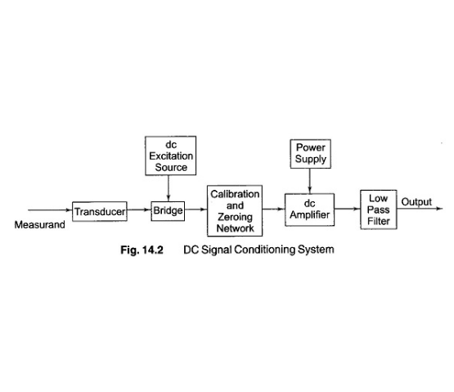
Why "Condition" the Signal?
Raw output from sensors (like Thermocouples or Strain Gauges) is often useless because:
Too Weak: Millivolts (mV) or microamps (µA).
Noisy: Contains electrical interference (50Hz hum, EMI).
Impedance Mismatch: Cannot drive a load.
Non-Linear: Output doesn't match input 1:1.
Signal Conditioning prepares it for the computer/display.

Slide 4







Operational Amplifiers (Op-Amps)
The Op-Amp is the fundamental building block of analog electronics. It has two inputs (Inverting , Non-Inverting ) and one output.
Infinite Input Impedance
Infinite Gain
Zero Output Impedance
Open loop gain is massive (100,000+). We control it with feedback.
Can drive any load without voltage drop. (Ideal)
Draws ZERO current from the sensor. (Ideal)

Slide 5
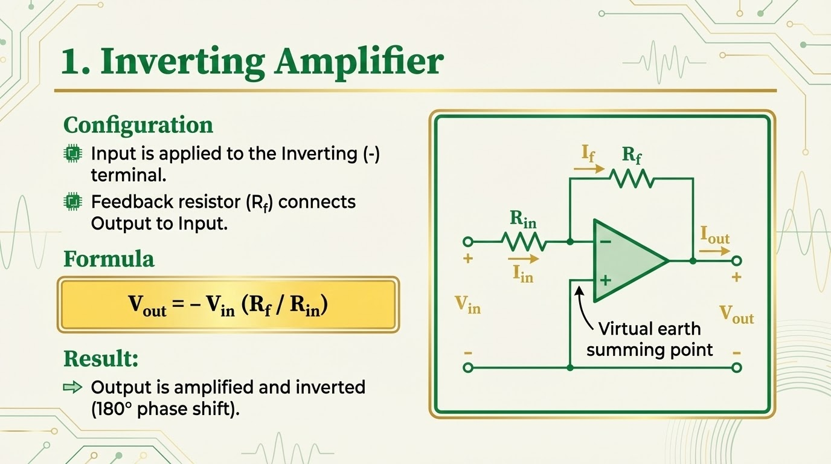

Slide 6
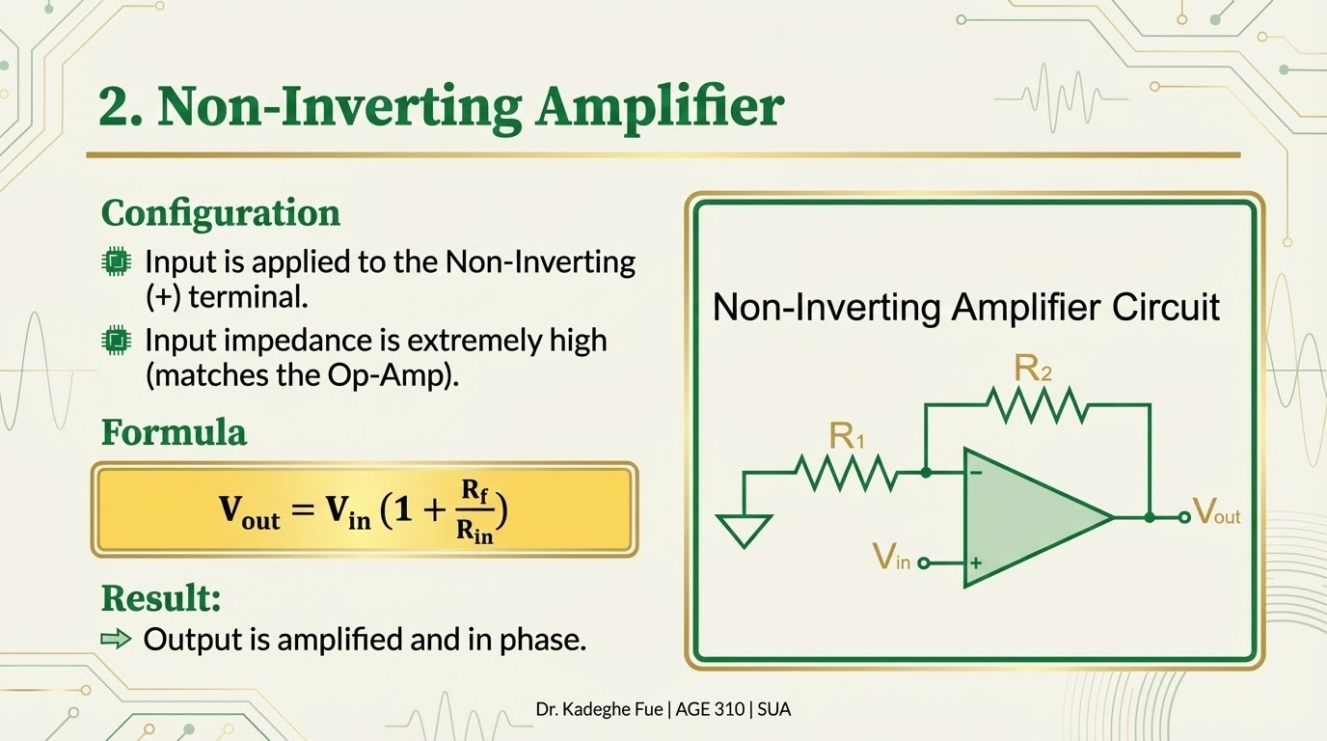

Slide 7
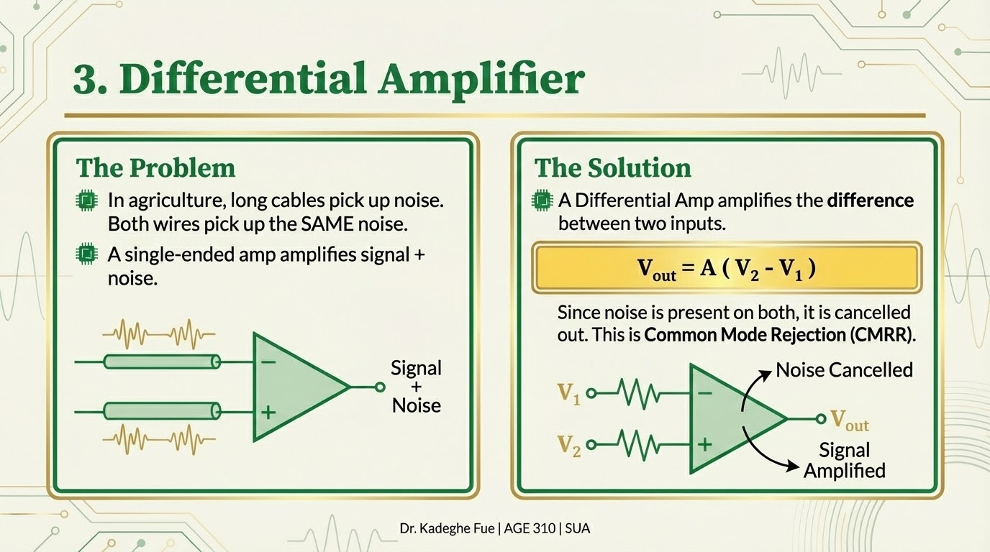

Slide 8
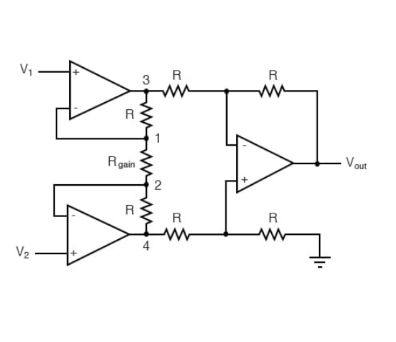
The Instrumentation Amplifier
The "Gold Standard"
Combines 3 Op-Amps to create the ultimate amplifier for sensors.
Extremely high input impedance (Buffer amps).
High CMRR (rejects noise).
Gain set by a single external resistor ( ).
Usage: Strain gauges, Load cells, Medical devices.

Slide 9


Filtering
Removing unwanted frequencies from the signal.
Active Filters
Passive Filters
Use Op-Amps + RC.
Made of Resistors and Capacitors (RC).
Can filter AND amplify at the same time. No signal loss.
Cheap but signal strength is lost (Attenuation).

Slide 10
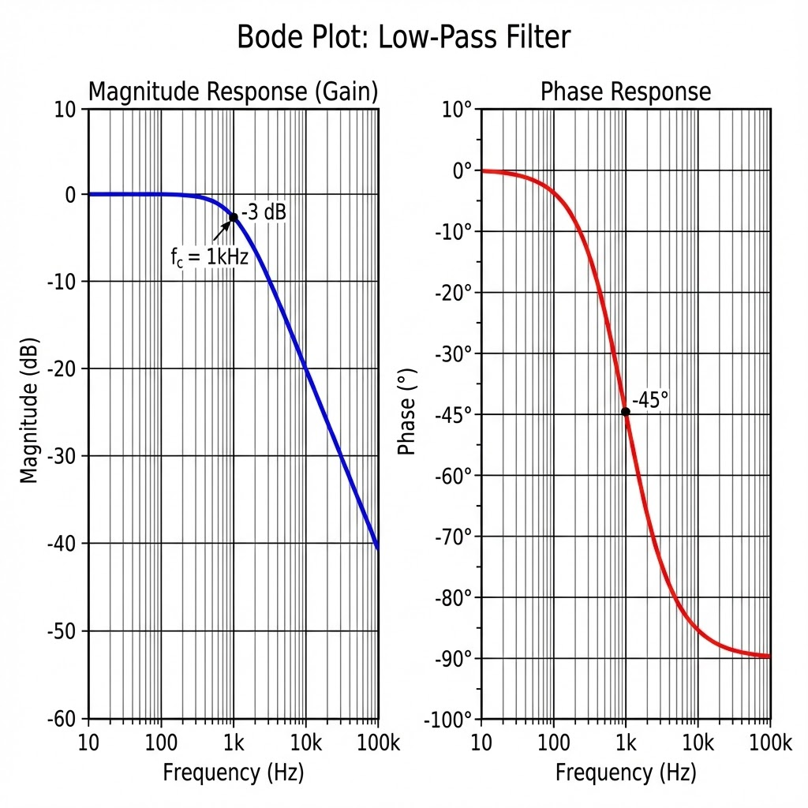
Filter Types
Low Pass: Allows low frequencies (DC sensors), blocks high freq (Noise). *Most common in Ag.*
High Pass: Blocks DC, allows high freq (Vibration analysis).
Band Pass: Allows a specific range (Radio).
Notch Filter: Blocks a specific frequency (e.g., 50Hz Mains Hum).

Slide 11

Analog to Digital Conversion (ADC)
To process data in a computer or microcontroller (Arduino), we must digitize it.
Sampling
Quantization
Taking a "snapshot" of the voltage at regular time intervals.
Assigning a numerical value (binary) to that voltage snapshot.
(Time discretization)
(Amplitude discretization)

Slide 12

ADC Resolution (Bit Depth)
How many steps can we divide our voltage range into?
Bit Depth | Steps | Resolution (0-5V)
8-bit | 256 | 19.5 mV (Coarse)
10-bit (Arduino) | 1024 | 4.9 mV (Standard)
16-bit | 65,536 | 0.076 mV (High Precision)

Slide 13
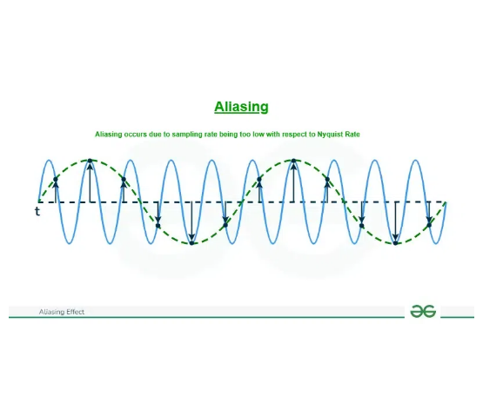
Sampling Rate & Aliasing
Nyquist Theorem
To capture a signal correctly, you must sample at least twice as fast as the highest frequency component.
Aliasing: If you sample too slowly, high-frequency signals look like low-frequency noise (Ghost signals).

Slide 14
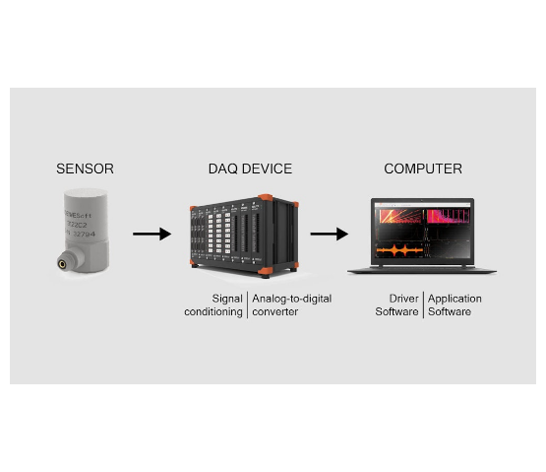
Data Acquisition (DAQ) Systems
The Complete Package
A DAQ device typically contains:
1.
Multiplexer (MUX): Switches between multiple sensors.
2.
Amplifier: Boosts signals.
3.
ADC: Digitizes data.
4.
Computer Interface: USB, Wi-Fi, Ethernet.
Example: National Instruments or LabJack (used in our labs).

Slide 15








Practical Example: Load Cell DAQ
1. Sensor
2. Amp
3. Filter
4. ADC
Instrumentation Amp
12-bit conversion
Strain Gauge Bridge
Low Pass (10Hz)
Gain: 1000x
Digital Value: 1638
Removes vibration noise.
Output: 2 V
Output: 2 mV (Very weak)

Slide 16
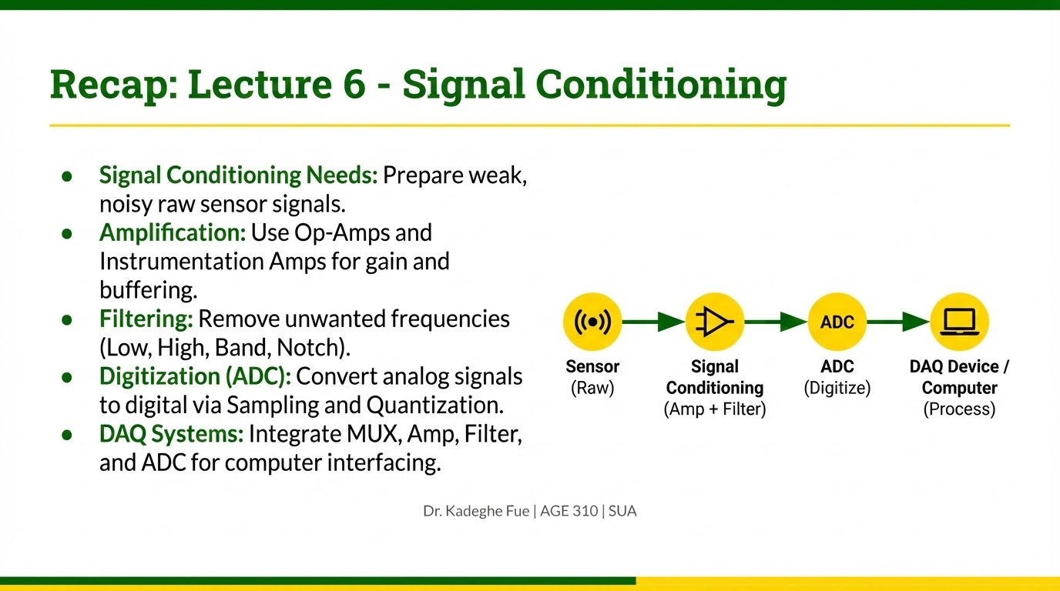

Slide 17

Discussion
End of Lecture 6
Assignment: Calculate the feedback resistor needed for an Inverting Amp to have a Gain of -50 if the input resistor is 1kΩ.
Next Class: Actuators and Final Control Elements (Motors, Solenoids, Hydraulics).
Dr. Kadeghe Fue | AGE 310 | SUA

